Slide 1



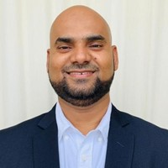
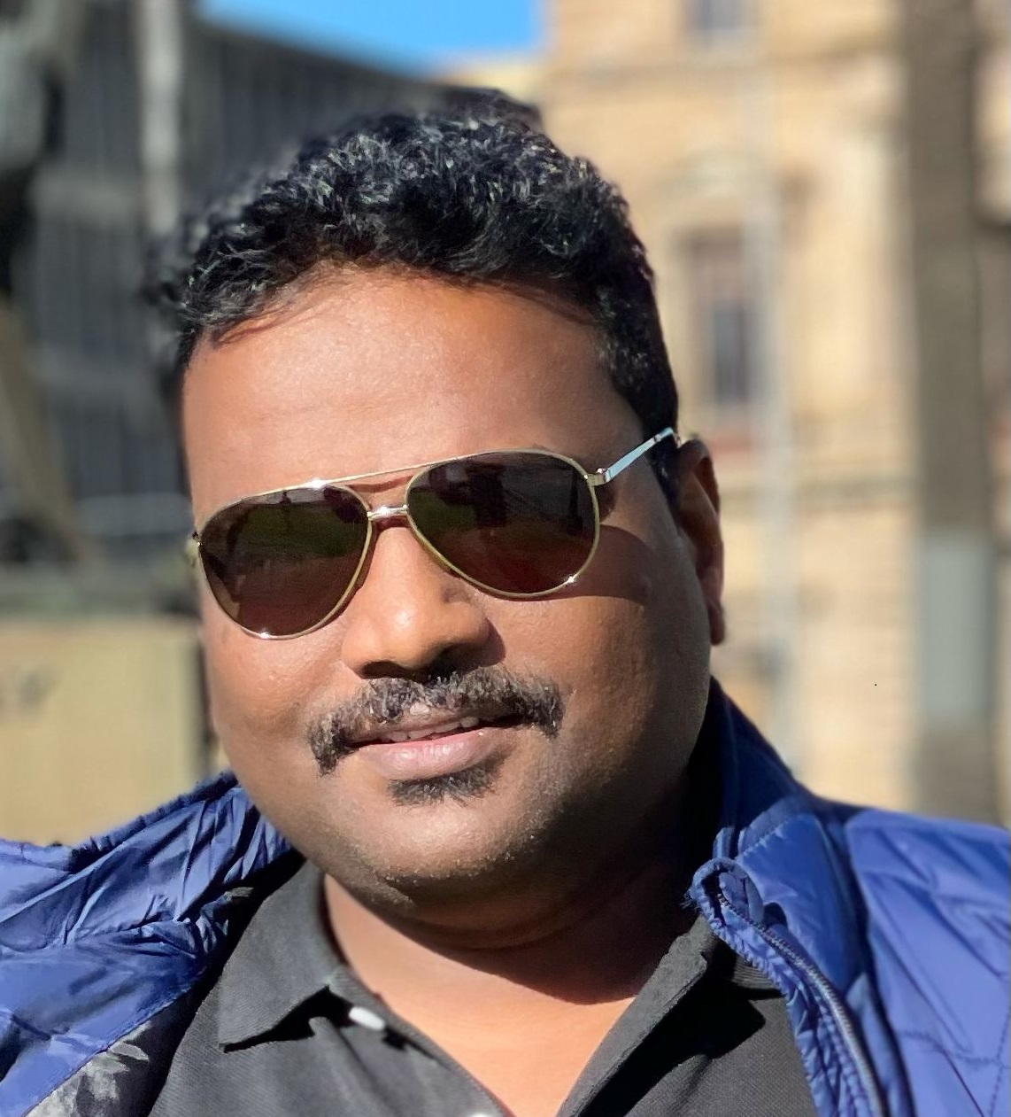



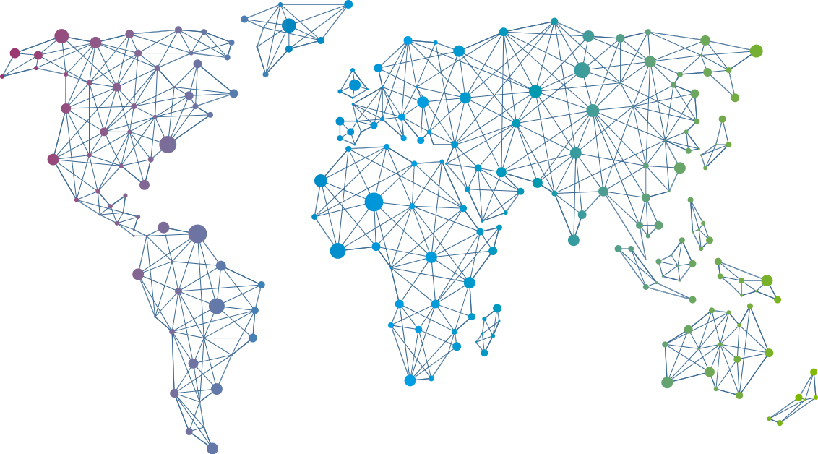

Speaker
Hasnain Shaikh & Sebastain Gomes
Zero Trust Approach to Secure Azure Workloads
Hasnain Shaikh
Sebastain Gomes
Hasnain__Shaikh
Sebastain Gomes
September 16th & 17th
^{Online Event}
Powered By
International Conference

